Slide 1
Introducing Interactions into Multiple Regression Models
PSYC234 Week 13
Emma Mills e.mills@lancaster.ac.uk
Notes:
https://www.youtube.com/watch?v=5ohlA__xABw - venkman poor experiment clip

Slide 2
Interactions
When one variable moderates the effect of another variable on the outcome variable
Or
When a coefficient for one predictor changes its size when it moves between the levels or values of another predictor
Or
The change that one predictor predicts for the outcome variable depends on a specific level of another predictor
Moderation – a process for exploring the differing conditions under which two or more variables may work together.
Notes:
WBA qs
The overarching system for dealing with categorical predictors in regression is by: contrast coding, dummy coding, treatment coding, sum coding, deviation coding

Slide 3
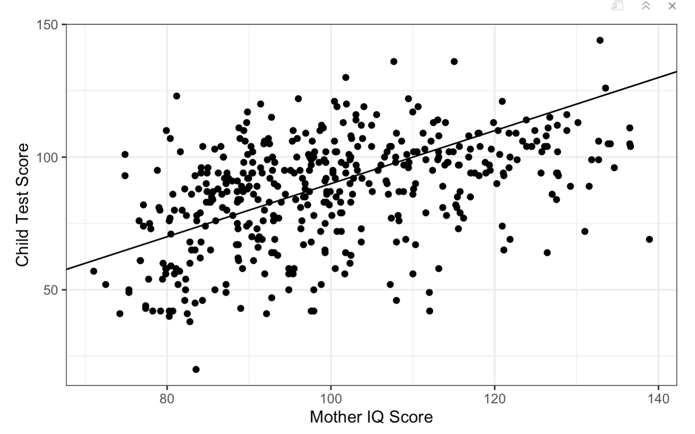
Simple Regression
slope black
Error for an individual point
Intercept black

Slide 4
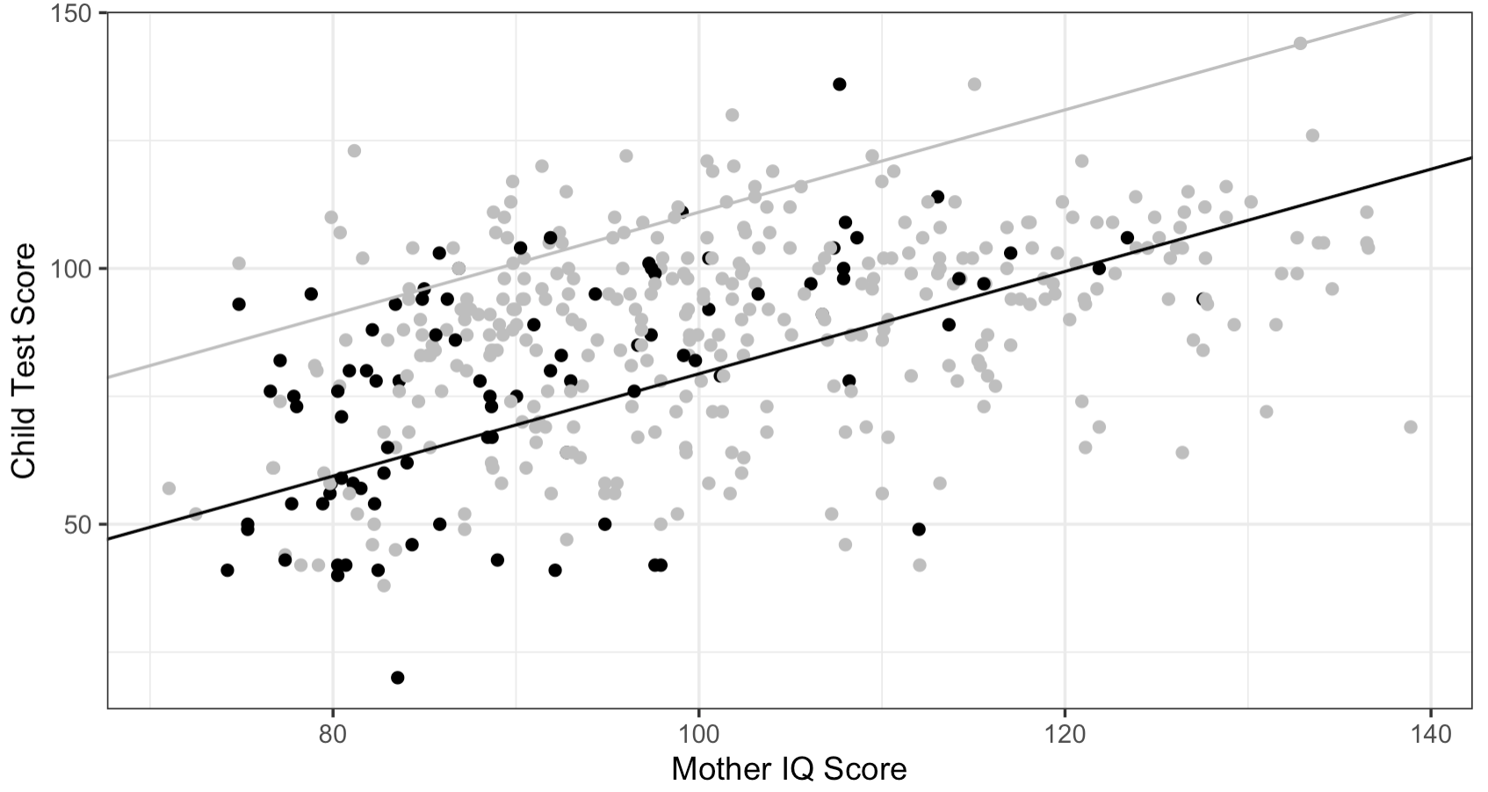
No interaction in the presence of two groups
slope grey
slope black
Intercept grey
Parallel lines indicate no difference in the slopes of two groups across the range of values in Mother’s IQ
Intercept black

Slide 5
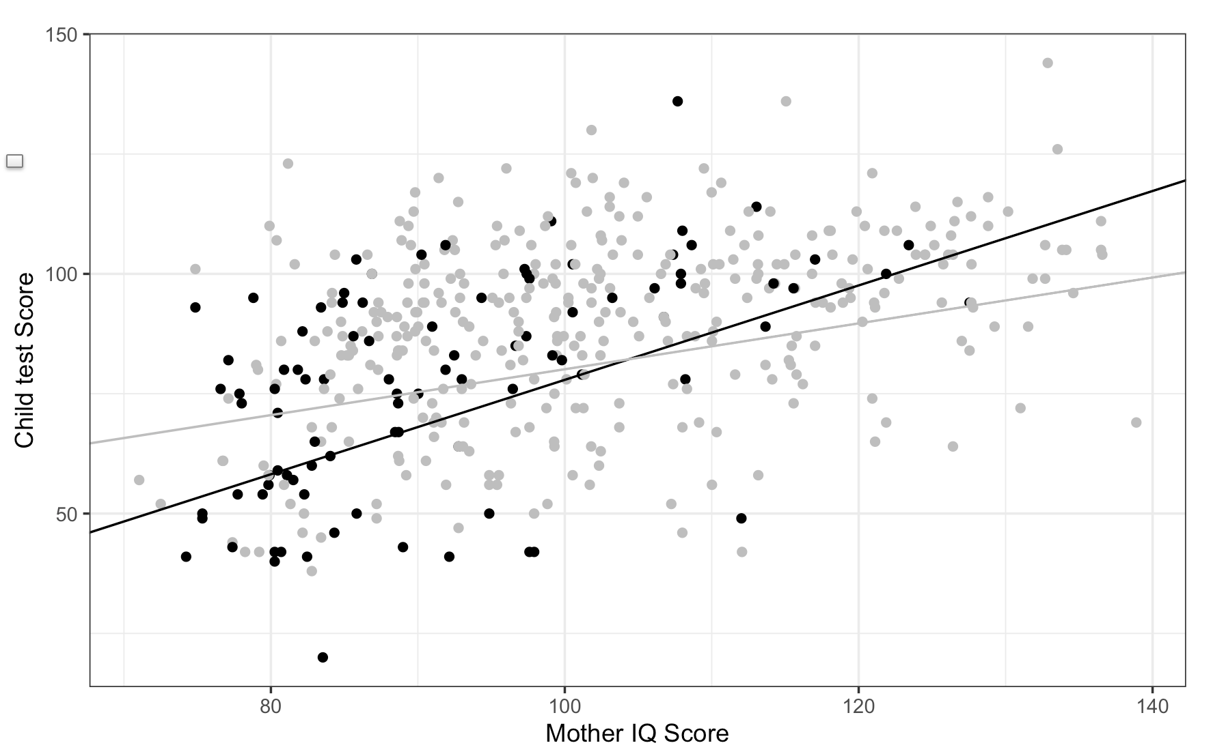
Different rates of change across levels of one predictor for the levels of another predictor
slope black
slope grey
Intercept
grey
Red arrows are the same length. See how they are too long for parts of the group difference slopes
Intercept
black

Slide 6
Interaction!!!
slope black
slope grey
Intercept
grey
Red arrows are the same length. See how they are too long for parts of the group difference slopes
Intercept
black

Slide 7
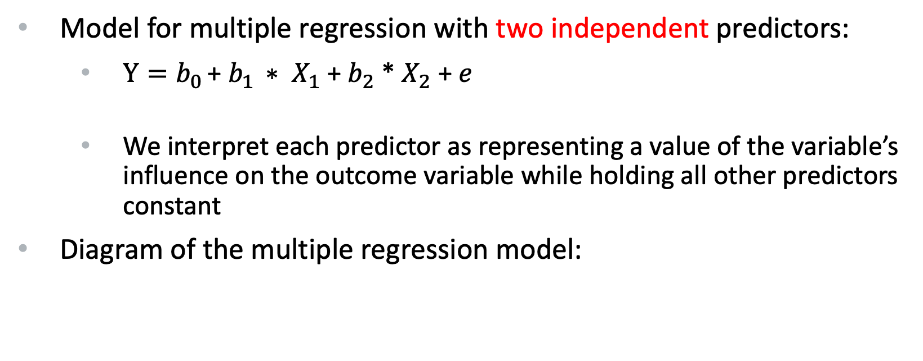
What are interaction terms?
Model for multiple regression with two independent predictors:
$Y=b_{0 }$+ $b_{1 }∗ X_{1}$ + $b_{2}$ * $X_{2}$ + $e$
We interpret each predictor as representing a value of the variable’s influence on the outcome variable while holding all other predictors constant
Diagram of the multiple regression model:
X₁
X₁ and X₂ do not talk to each other – only Y
Y
X₂
Notes:
WBA qs
The overarching system for dealing with categorical predictors in regression is by: contrast coding, dummy coding, treatment coding, sum coding, deviation coding

Slide 8
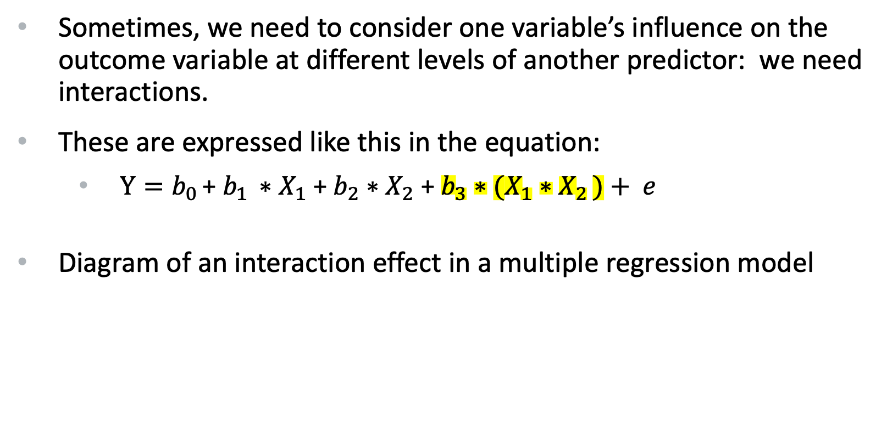
What are interaction terms?
Sometimes, we need to consider one variable’s influence on the outcome variable at different levels of another predictor: we need interactions.
These are expressed like this in the equation:
$Y=b_{0 }$+ $b_{1 }∗X_{1}$ + $b_{2}∗X_{2}$ + $b_{3}∗(X_{1}{∗X}_{2 })+ e$
Diagram of an interaction effect in a multiple regression model
X₂
X₁ and X₂ do talk to each other – and they both talk to Y
X₁
Y
Notes:
WBA qs
The overarching system for dealing with categorical predictors in regression is by: contrast coding, dummy coding, treatment coding, sum coding, deviation coding

Slide 9
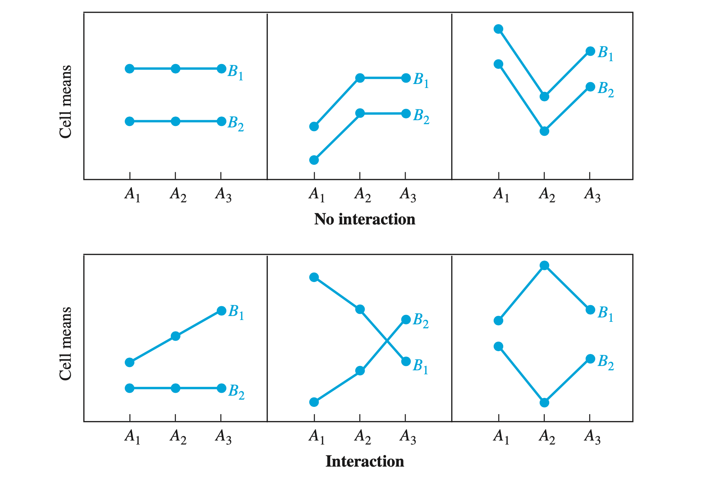

Slide 10
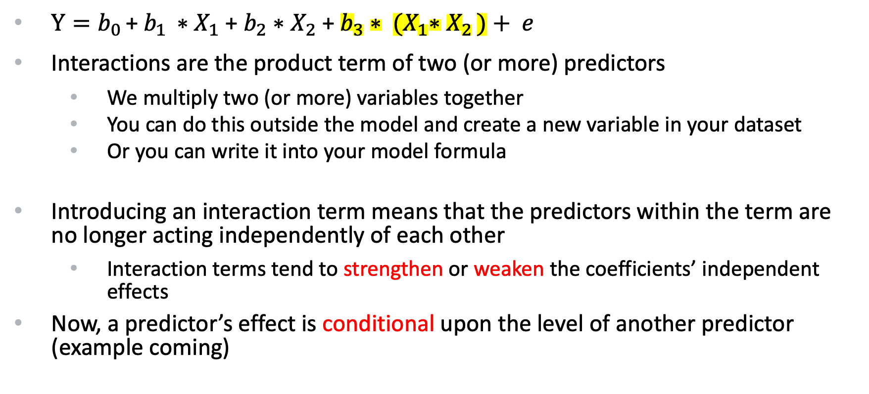
What are interaction terms?...con’t
$Y=b_{0 }$+ $b_{1 }∗X_{1}$ + $b_{2}∗X_{2}$ + $b_{3}∗ {(X}_{1}{∗X}_{2 })+ e$
Interactions are the product term of two (or more) predictors
We multiply two (or more) variables together
You can do this outside the model and create a new variable in your dataset
Or you can write it into your model formula
Introducing an interaction term means that the predictors within the term are no longer acting independently of each other
Interaction terms tend to strengthen or weaken the coefficients’ independent effects
Now, a predictor’s effect is conditional upon the level of another predictor (example coming)
Notes:
WBA qs
The overarching system for dealing with categorical predictors in regression is by: contrast coding, dummy coding, treatment coding, sum coding, deviation coding

Slide 11
When are interaction terms used?
Theory may predict them
Research questions / hypotheses may predict them
Study design may implicitly suggest them (groups?)
Results may suggest them
Regression coefficients that seem large when modelled independently may suggest the need for an interaction term
Make sure you are aware of where you are in the analysis workflow
Don’t just add them
Save any unplanned additions of interaction terms for an exploratory analysis phase…
Notes:
WBA qs
The overarching system for dealing with categorical predictors in regression is by: contrast coding, dummy coding, treatment coding, sum coding, deviation coding

Slide 12
What is the statistical power of interactions?
Many effect sizes in psychology hover around Cohen’s d = 0.4
Based upon an effect size like this:
The power of an interaction can be a small as 1/16th of the independent effects within a model (Gelman et al. 2020)
This is for ANOVA and regression methods
This is when all the assumptions of the model are met
Most models violate model assumptions in some way
Although relatively tolerant of violations:
Power of the effects are thus reduced further…
Something to consider…
Notes:
WBA qs
The overarching system for dealing with categorical predictors in regression is by: contrast coding, dummy coding, treatment coding, sum coding, deviation coding

Slide 13
Preparation of data for using interactions:
Centre or standardise your continuous variables
Standardising puts both predictors on the same scale
So interpreting the effect of one predictor on the other will be using the same scale of units
Consider how to use your categorical variables
Dummy coding..?
Sum coding..?
Making new binary variables…?
Coercing a binary variable to numeric class and mean centring
(so many choices! So little time!)
Notes:
WBA qs
The overarching system for dealing with categorical predictors in regression is by: contrast coding, dummy coding, treatment coding, sum coding, deviation coding

Slide 14
Building a model with interactions:
Plan to build the model suggested by your research questions / hypotheses / theory
If that includes the interaction term, build it as the first model
If not,
Build an independent predictor model first
Build a further model that includes independent and interaction terms
Question: does a study design that uses different groups of people, implicitly motivate an interaction term?
Notes:
WBA qs
The overarching system for dealing with categorical predictors in regression is by: contrast coding, dummy coding, treatment coding, sum coding, deviation coding

Slide 15
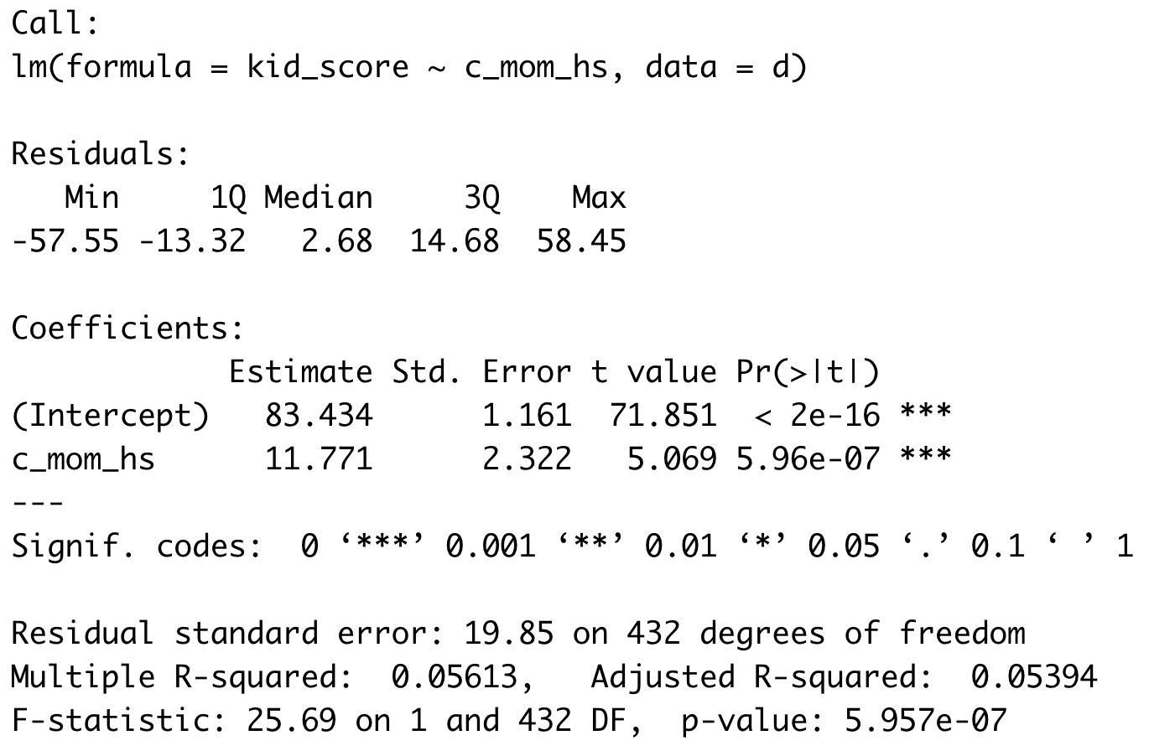
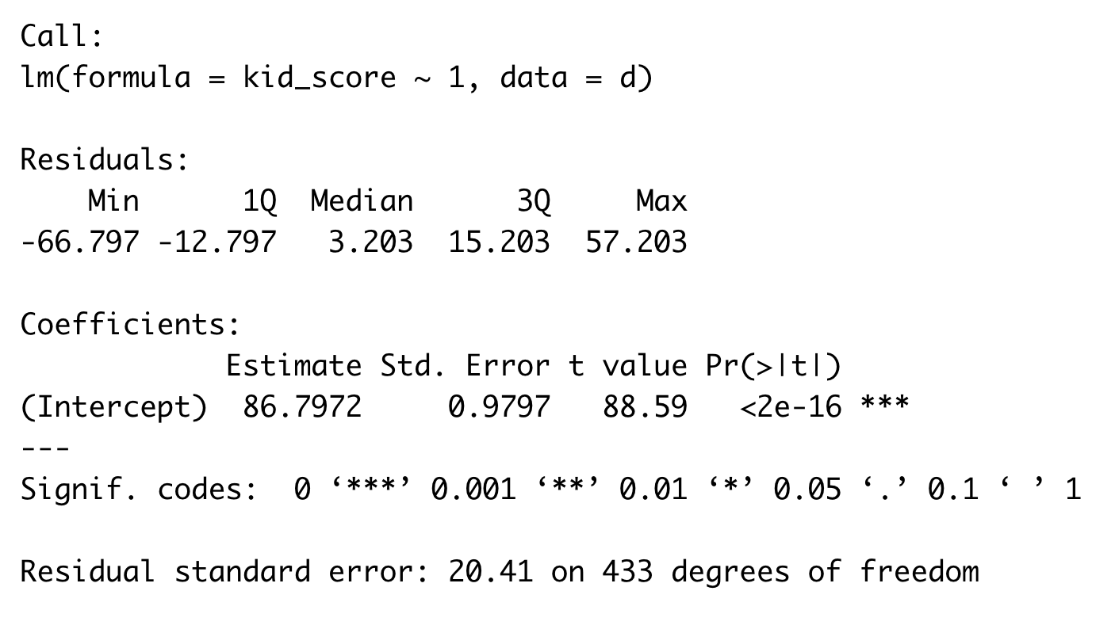
This implies more than one model…: multiple regression = multiple models
A cautious and conservative approach to multiple regression is to create several models, each one building upon the next
These are called “nested” models
Every model uses exactly the same data
The latest model has all of the previous models within it
The latest model can differ by +1 predictor or more
Notes:
WBA qs
The overarching system for dealing with categorical predictors in regression is by: contrast coding, dummy coding, treatment coding, sum coding, deviation coding

Slide 16
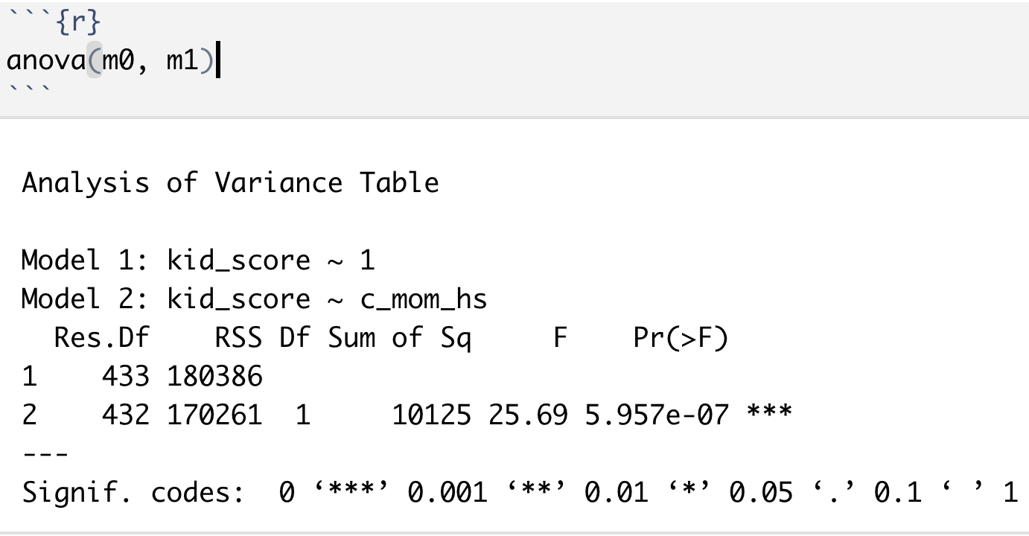
Which model do I report..?
You can inspect the R2 or adj. R2 values to see if the more complex model explains more variance in the outcome variable
But more principled is to use an inferential test:
Use anova() to formally test the null hypothesis that two models explain the same amount of variance in the outcome variable = model comparison
If so, p-value is > .05,
we fail to reject the null hypothesis
AND we choose the simpler model
If the p-value of the anova < .05
we reject the null hypothesis
we choose the more complex model
Notes:
WBA qs
The overarching system for dealing with categorical predictors in regression is by: contrast coding, dummy coding, treatment coding, sum coding, deviation coding

Slide 17
Which model do I report..?
You can inspect the R2 or adj. R2 values to see if the more complex model explains more variance in the outcome variable
But more principled is to use an inferential test:
Use anova() to formally test the null hypothesis that two models explain the same amount of variance in the outcome variable = model comparison
If so, p-value is > .05,
we fail to reject the null hypothesis
AND we choose the simpler model
If the p-value of the anova < .05
we reject the null hypothesis
we choose the more complex model
Notes:
WBA qs
The overarching system for dealing with categorical predictors in regression is by: contrast coding, dummy coding, treatment coding, sum coding, deviation coding

Slide 18
Which model do I report..?
You can inspect the R2 or adj. R2 values to see if the more complex model explains more variance in the outcome variable
But more principled is to use an inferential test:
Use anova() to formally test the null hypothesis that two models explain the same amount of variance in the outcome variable = model comparison
If so, p-value is > .05,
we fail to reject the null hypothesis
AND we choose the simpler model
If the p-value of the anova < .05
we reject the null hypothesis
we choose the more complex model
Notes:
WBA qs
The overarching system for dealing with categorical predictors in regression is by: contrast coding, dummy coding, treatment coding, sum coding, deviation coding

Slide 19
Which model do I report..?
You can inspect the R2 or adj. R2 values to see if the more complex model explains more variance in the outcome variable
But more principled is to use an inferential test:
Use anova() to formally test the null hypothesis that two models explain the same amount of variance in the outcome variable = model comparison
If so, p-value is > .05,
we fail to reject the null hypothesis
AND we choose the simpler model
If the p-value of the anova < .05
we reject the null hypothesis
we choose the more complex model
Notes:
WBA qs
The overarching system for dealing with categorical predictors in regression is by: contrast coding, dummy coding, treatment coding, sum coding, deviation coding

Slide 20
Building a series of models: hazard warning!
This is where p-hacking and cherry picking and HARKing can occur really easily
Strategies to defend against such questionable research practices: (remember from PSYC123 last year)
State clearly whether you are in confirmatory or exploratory analysis mode
Explain your process to yourself and your future reader before you start (at best in a pre-registration; at the very least before you begin)
Report all models – use a script such as .Rmd file or an interactive notebook so that the process is recorded and can be reproduced
Be honest and comprehensive in your reporting.
Notes:
WBA qs
The overarching system for dealing with categorical predictors in regression is by: contrast coding, dummy coding, treatment coding, sum coding, deviation coding

